Slide 1
St Jude India ChildCare Centres
Team-3
CFG 2020
JP Morgan Chase and Co.

Slide 2
PROBLEM STATEMENT
Providing a clean, safe and cost-free accommodation to children and their relatives coming from small cities and are undergoing treatment of chronic diseases in metro cities in India

Slide 3
OBJECTIVES AND SCOPE
Provide safe, clean and cost free accomodations to children
Design a efficient feedback system to receive maximum feedback.
Avail Donors with facilities an information about their money expense.
Encourage more donors to provide donations, houses etc for children
Feedback analysis by the admin so that they can act on them and make child experience better

Slide 4
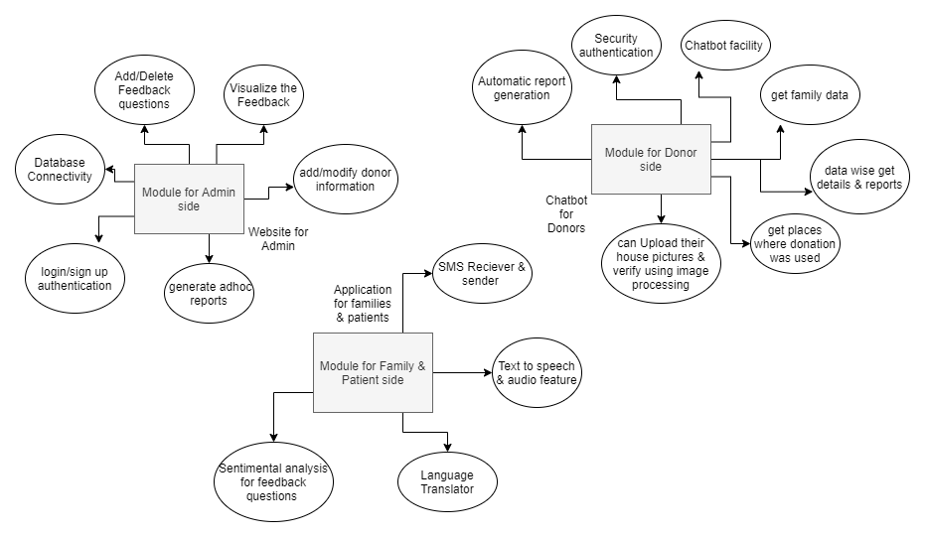
SYSTEM DIAGRAM

Slide 5
FEEDBACK SYSTEM
Feedback System is incorporated in two ways via mobile app.
Online feedback form
It is multilingual
It is for people with internet connection.
Available on the app.
Uses “smiley scrolling bar” for answers.
Requires validation of Patient ID and Space ID
Easy to fill

Slide 6
FEEDBACK SYSTEM
2. Offline feedback form
It is multilingual
It is for people without internet connection.
Available on SMS.
Uses “ranking (1-5)” for answers.
Requires registered mobile number
Easy to fill

Slide 7
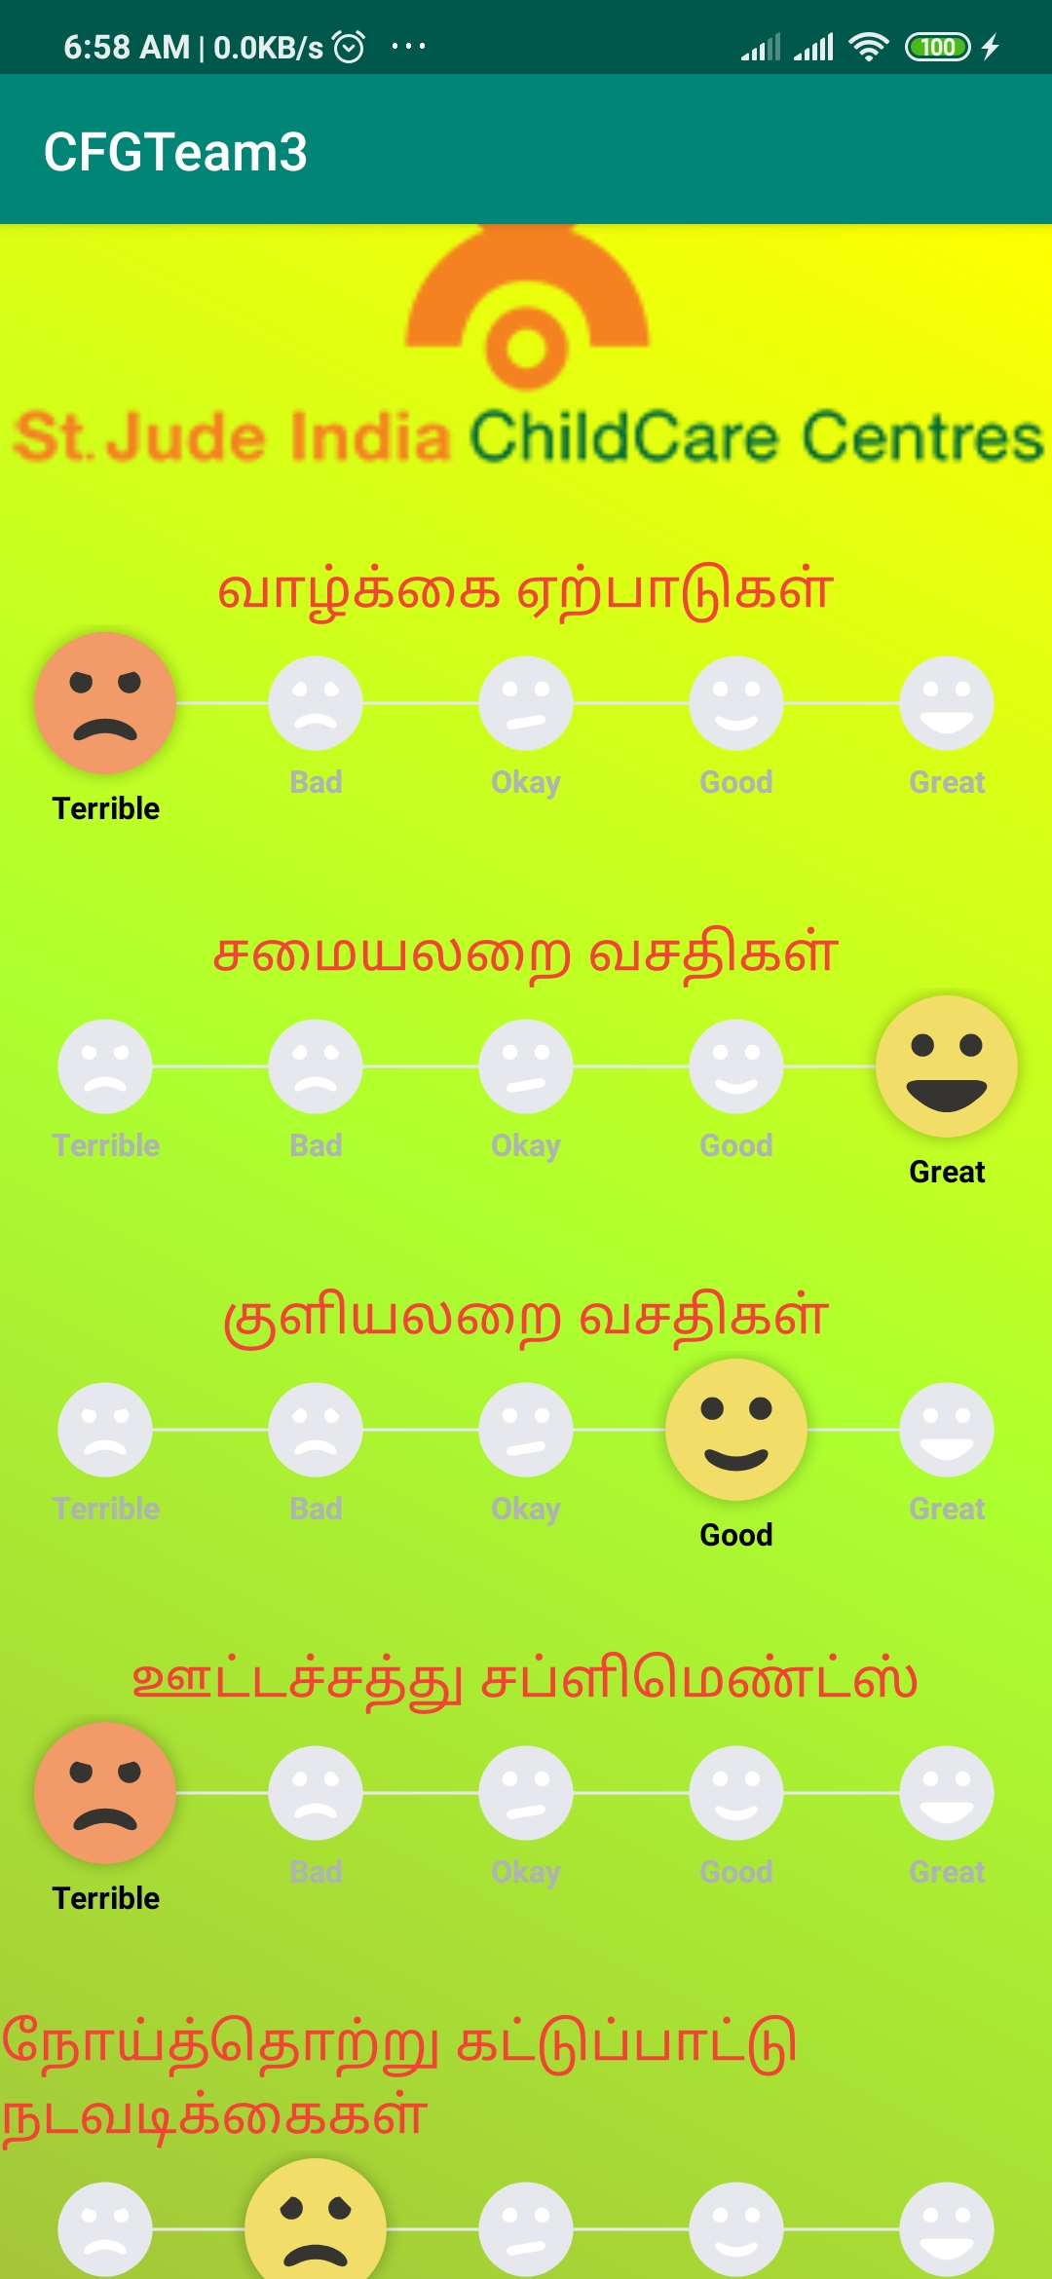
Feedback

Slide 8
DONOR
The Donor is provided with a Whatsapp Bot so that the donor can, according to his convenience get the details and records that they want. The donor is provided with following functionalities:
Get the report of the money/ amenities that donor has donated
Get the details of the Family staying at their home
Know the good deeds in which donor’s money was used
Year wise generate report, details of family and donations usage.
Get customer service support at any time.

Slide 9
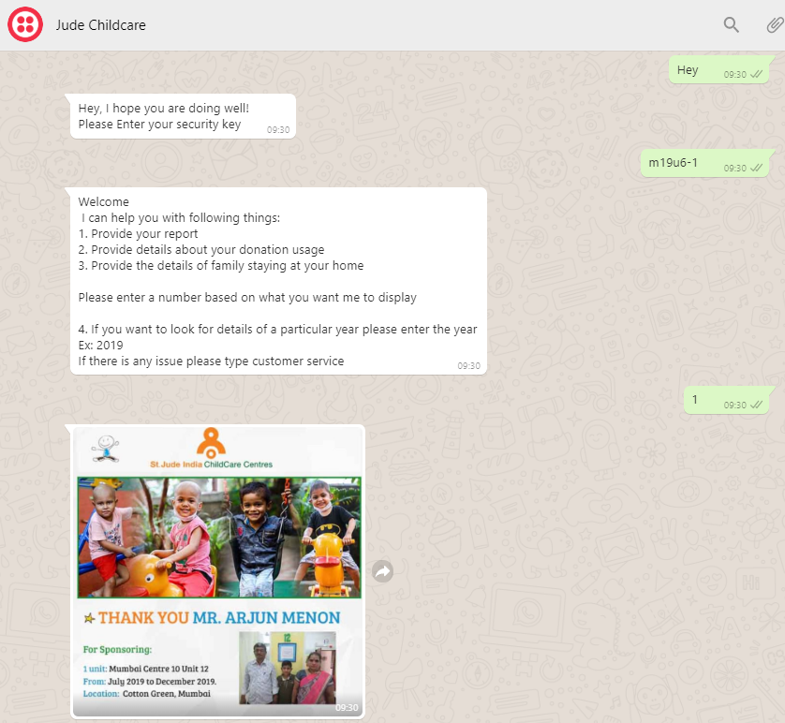
DONOR

Slide 10
ADMIN - WEBSITE
The Admin is provided with the website.The admin website has the following features:
1.View The patients list.
2.View Donor List
3.Add questions into the existing feedback form.
4.View the Overall Feedback of the Patients for their NGO.
5.Admins can send a weekly notification to their donors and patients regarding the feedback and updates.

Slide 11
ADMIN - APPLICATION
Via the mobile app,
admin can send the Feedback Form to the registered users.
admin can receive the response from the users which can then be updated in the database using JDBC connectivity.
The responses stored via mobile app are extracted and estimated through web app.

Slide 12
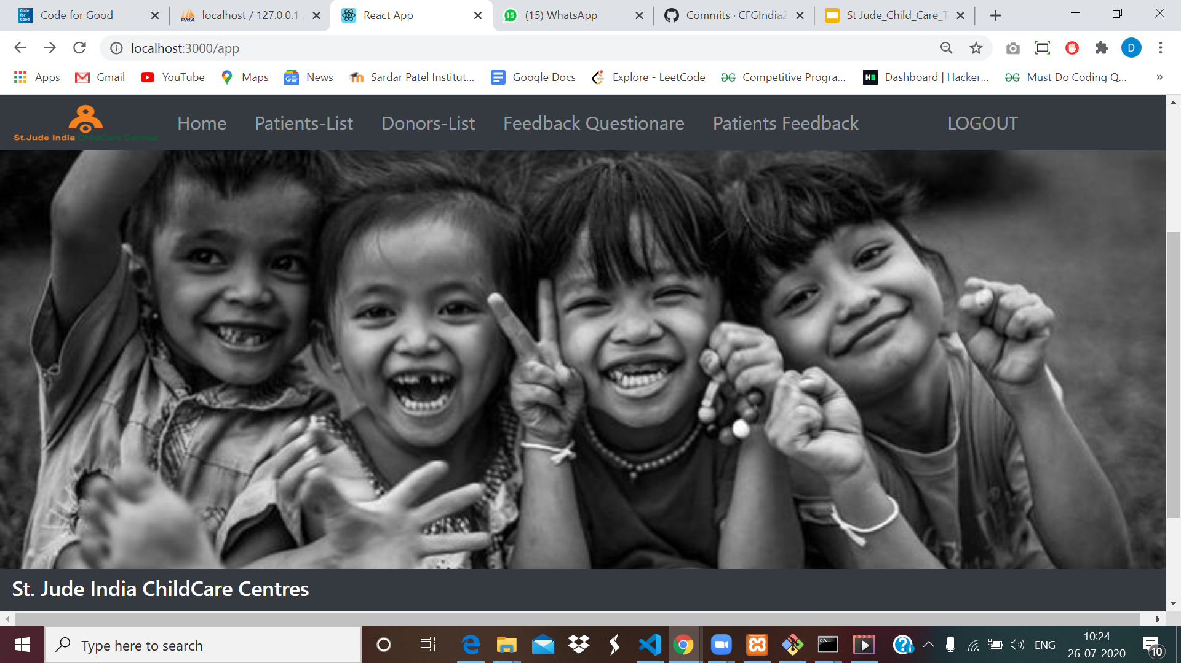

Slide 13
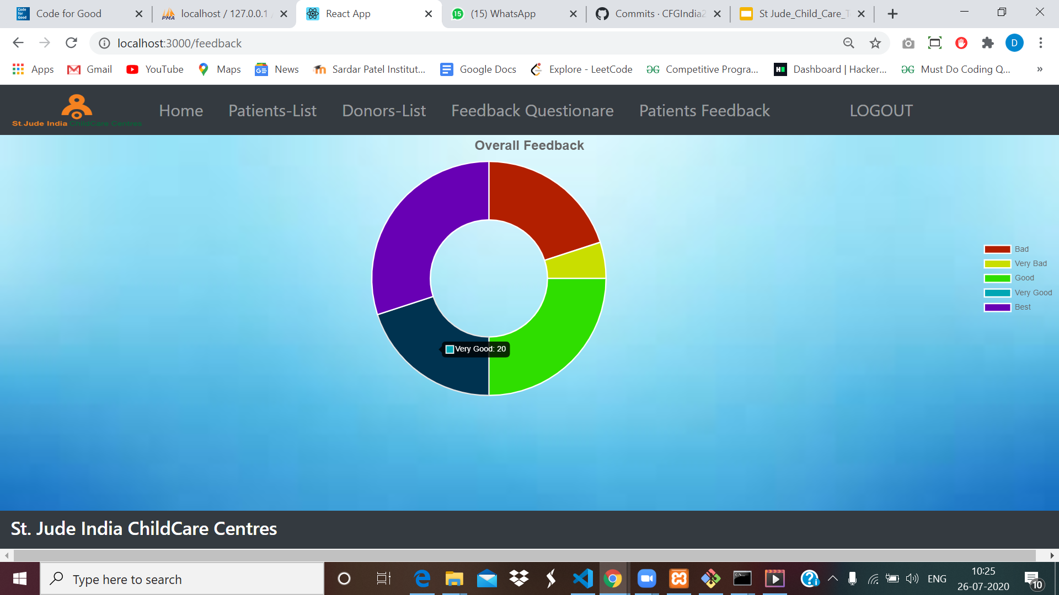

Slide 14
FUTURE ENHANCEMENT
Speech to text functionality in the SMS.
Image processing to check the hygiene of the unit, by uploading the pictures periodically.
Translation apis for multiple languages
A educational Recommender engines for mapping the child to a professor
Generate Ad hoc reports from the Admin Panel
Arranging the recurring alerts to the patients if they haven’t filled the feedback or they have changed their contact or in case of emergency through SMS.

Slide 15
PREREQUISITES
Parents should have a smartphone or a featured phone in order to provide feedbacks.
Stable internet connection to run the admin website.

Slide 16
CONCLUSION
In a very efficient way the problems faced by the NGO can be handled by our solution.
We provide with the three solutions.
An application for patients to add feedback.
An web portal for the admin to handle NGO functionalities.
An WhatsApp integrated chatbot for the donors to get in hand information regarding the children,their families,location of the units.
We provide many more future ideas which can incorporated by the NGOs to improve the overall services in their NGO.

Slide 17
REFERENCES
https://developer.android.com/
https://www.tutorialspoint.com/android/android_studio.htm
https://google-developer-training.github.io/android-developer-phone-sms-course/Lesson%202/2_p_sending_sms_messages.html

